Slide 1
Engineering Interactive Visual Interfaces for Data Science (“The CS Data Vis Class”)
xkcd

Slide 2
Wed Feb 5
Engineering Interactive Visual Interfaces for Data Science
“The CS Data Vis Class”
Dr. Jillian Aurisano
Plan for today:
Logistics
Design (and bad design)

Slide 3
Logistics
Project 1 checkpoint- Next Wed
An update on your progress
Your plan for completing the project
Let me know about issues

Slide 4
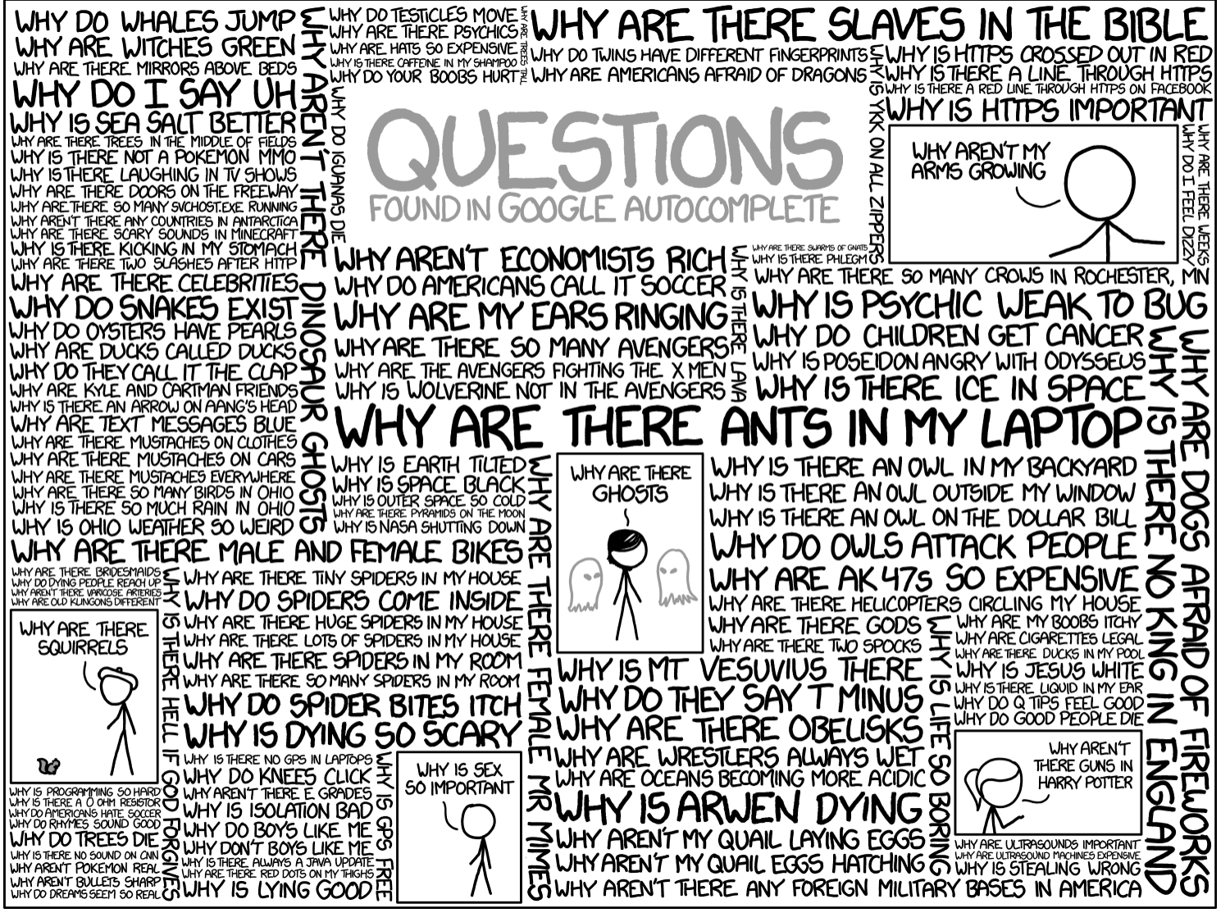
Questions?

Slide 5
Previously….
We’ve been talking about the technical side of implementing a visualization
Today, we are going to start talking less about how to make a visualization and more about what visualizations you should make
Starting with design principles – and examples from when people don’t follow them

Slide 6
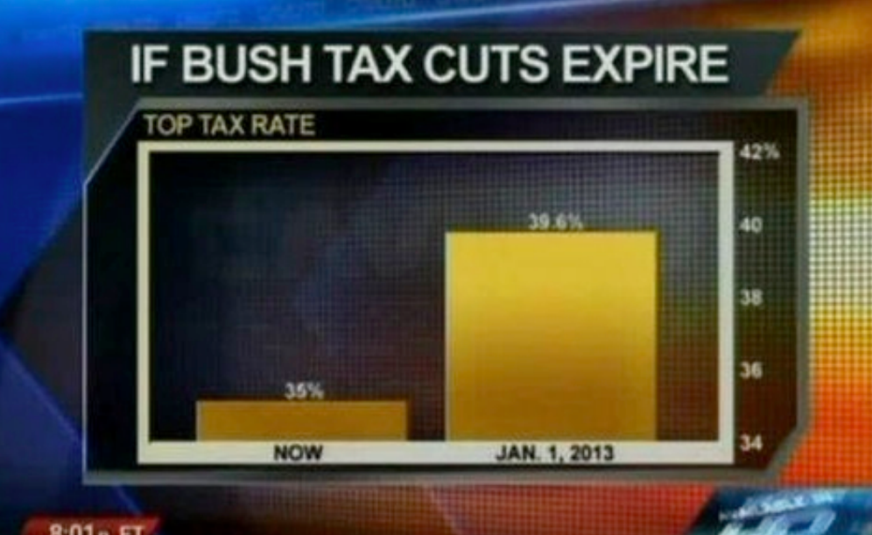
Design principle:
Size of the graphic effect should be directly proportional to the numerical quantities
(not everyone follows this …)

Slide 7
Lie Factor
Edward Tufte – vis researcher from 1980s
Lie Factor: the relation between the size of the effect in the data vs the size of the effect in the graphic
Effect in the data:
39.6/35 = 1.14
Effect in the Graphic:
Large rect is 5x’s longer
Lie factor:
5/1.14 = 4.38

Slide 8
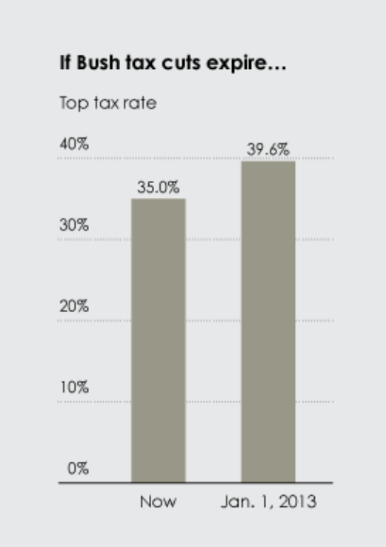
Scale distortion

Slide 9
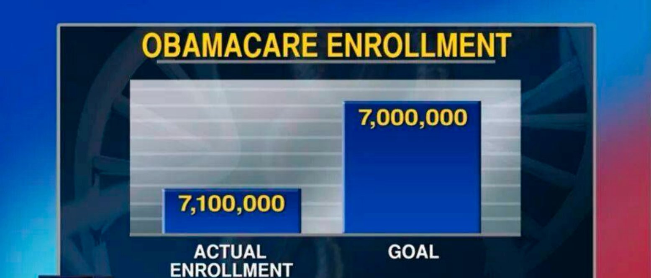

Slide 10
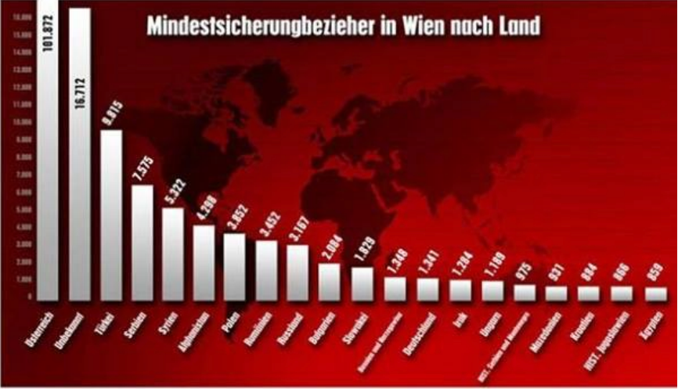
What’s wrong?

Slide 11
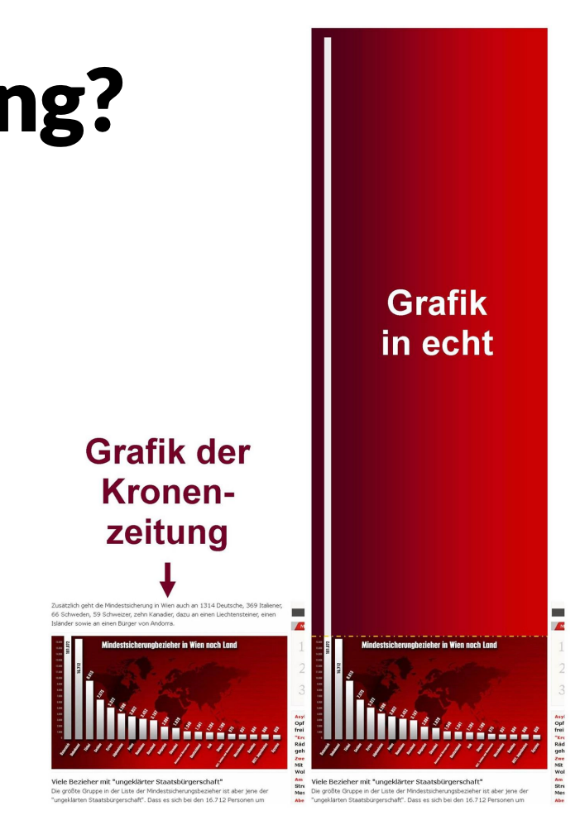

Slide 12
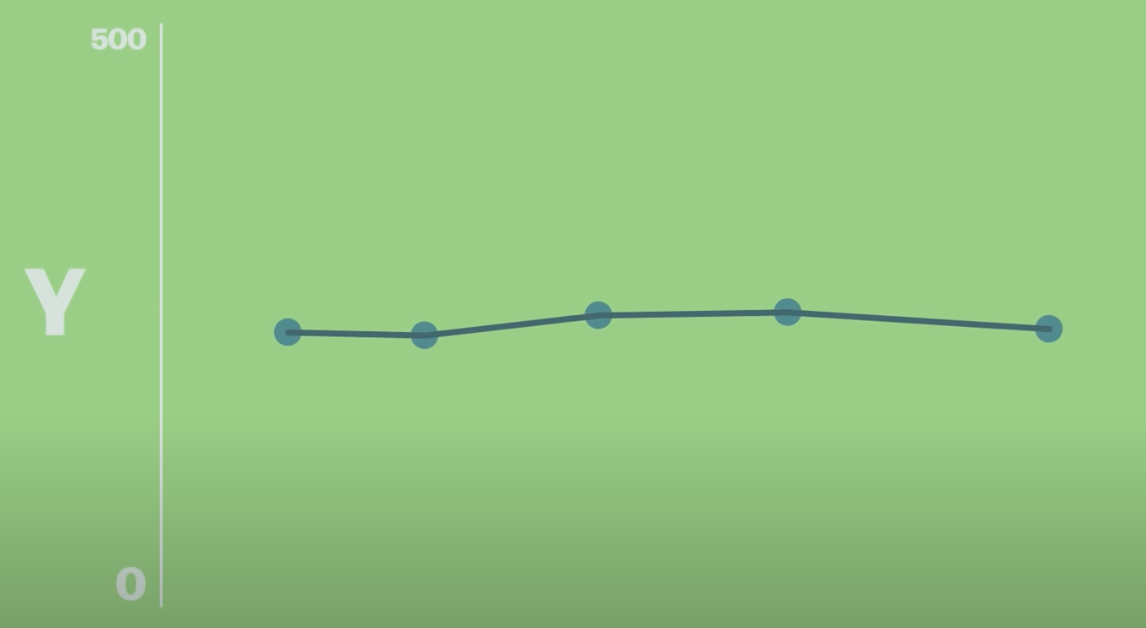
Does the scale always have to start at 0?
Consider this- how much change is there?
Vox.com

Slide 13
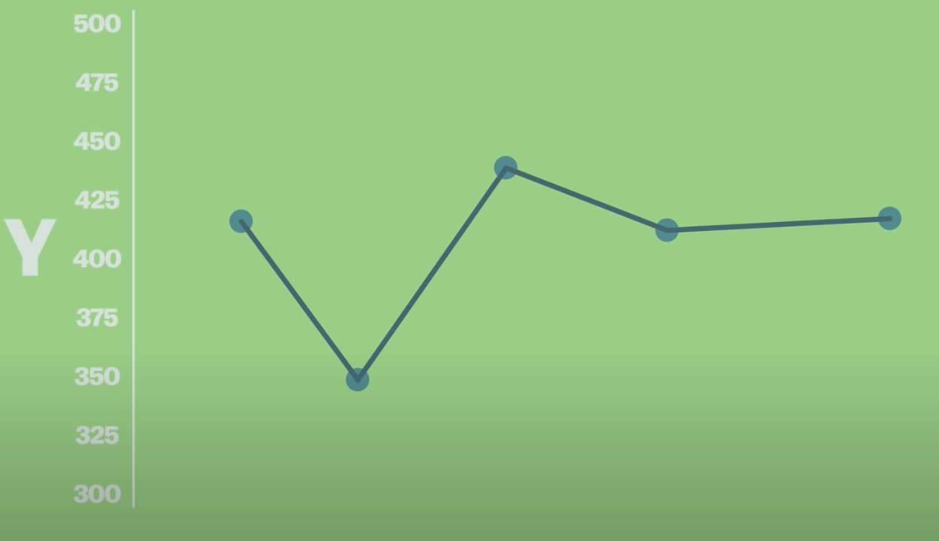
Does the scale always have to start at 0?
When is this justified?
Vox.com

Slide 14
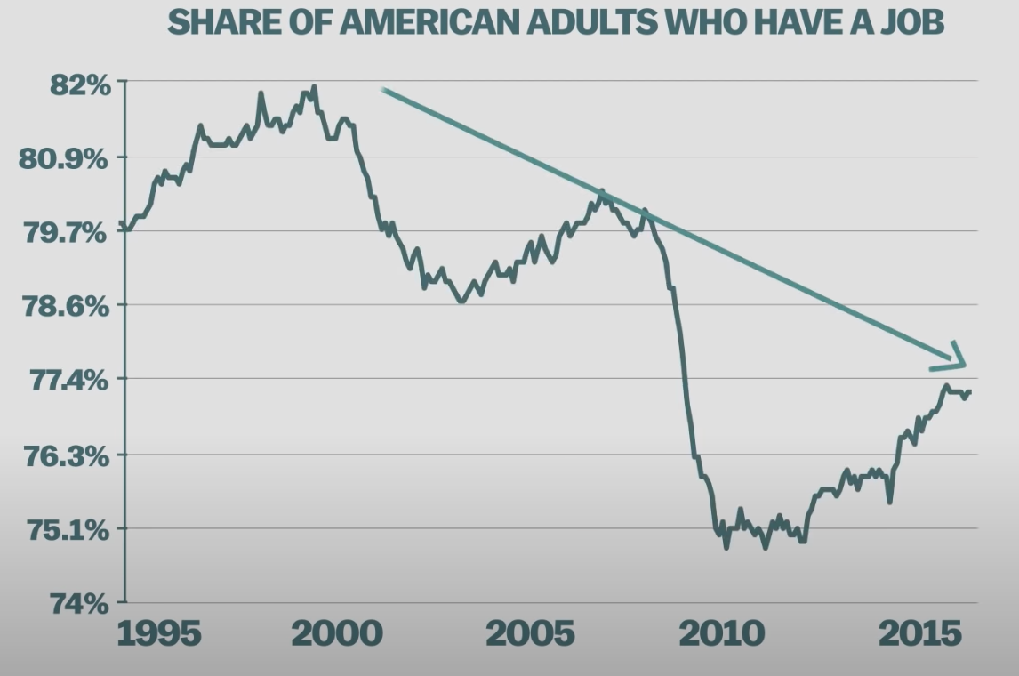
Let’s look at this visualization
This chart shows a 20 year period
That is a long time, considering that it could be someone’s entire time in the workforce
These lows are generational lows
-> A big deal
Vox.com

Slide 15
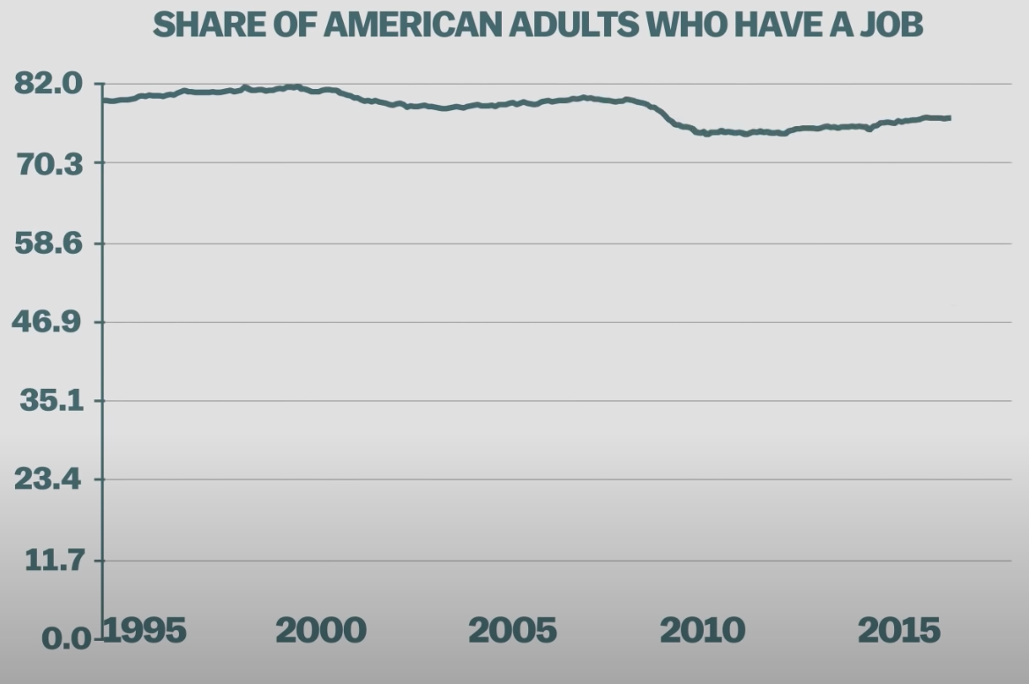
Can we see any change if we start at 0?
Is 0 the true baseline?
Do we ever see 0% of Americans without a job?
With a non-zero start to our y-axis, are we emphasizing what is relevant?

Slide 16
“Use a baseline that shows the data, not the zero point”
Eduard Tufte

Slide 17
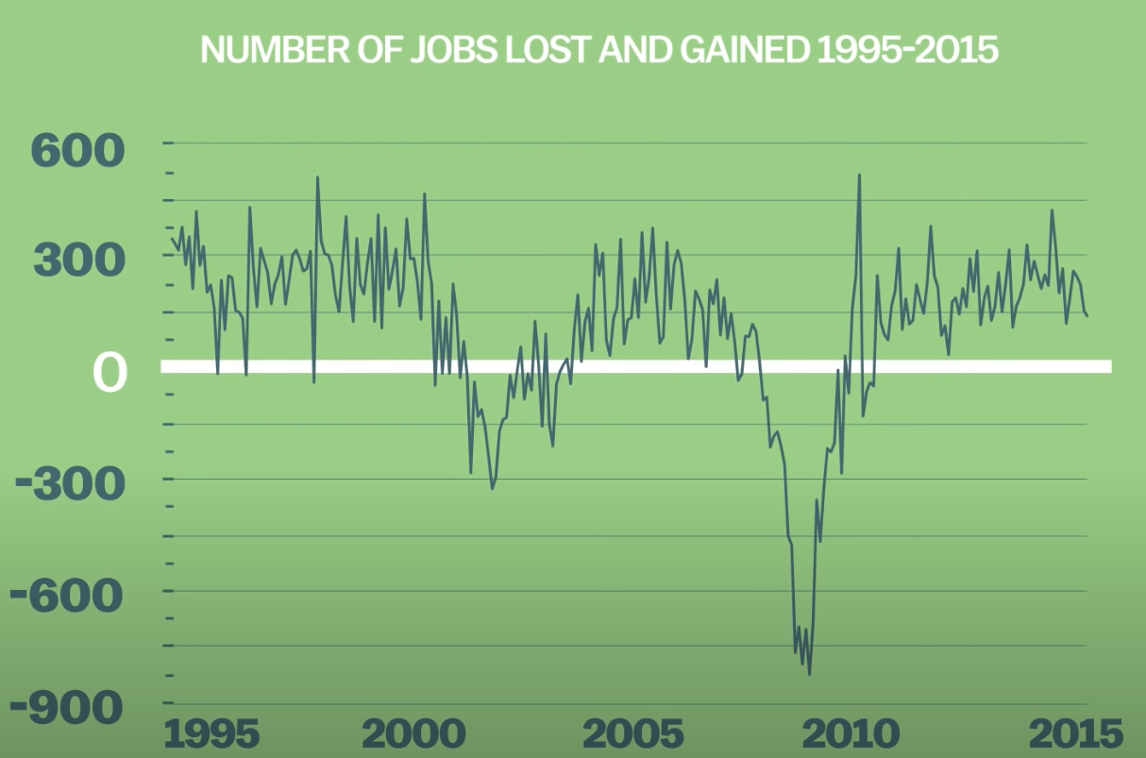
Sometimes your data goes below zero
Halting at 0 would be excluding lots of data
Vox.com

Slide 18
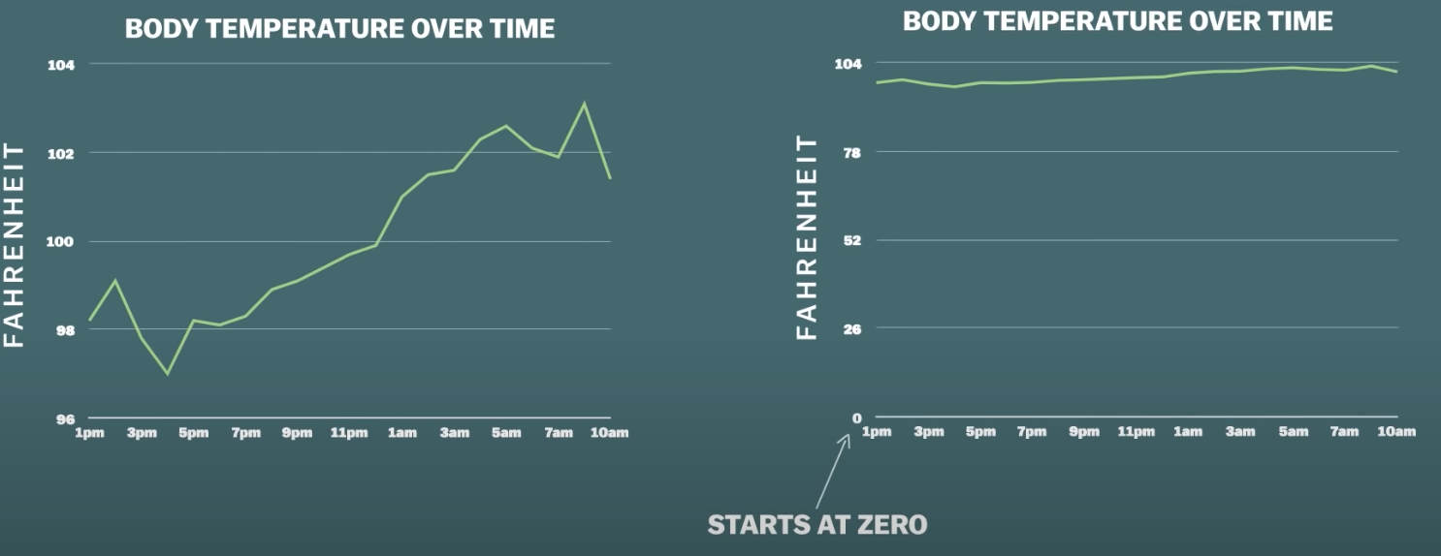
Another example
Vox.com

Slide 19
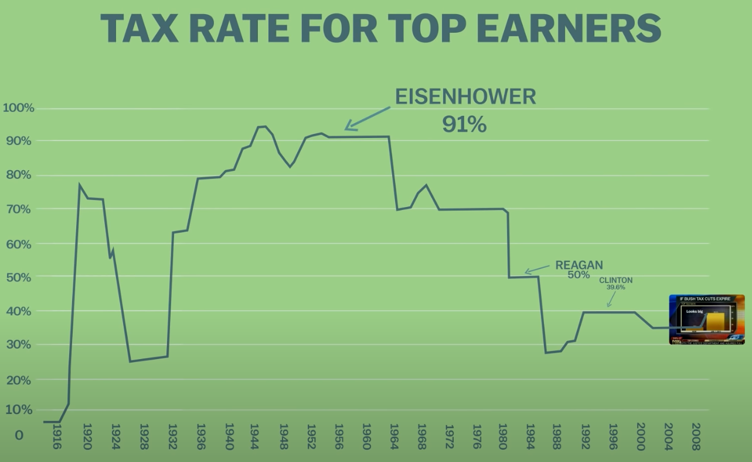
Sometimes what is missing is context
Vox.com

Slide 20
Y axes don’t mislead people
People mislead people

Slide 21
Our goal
The goal is to be faithful to the data and to show the context

Slide 22
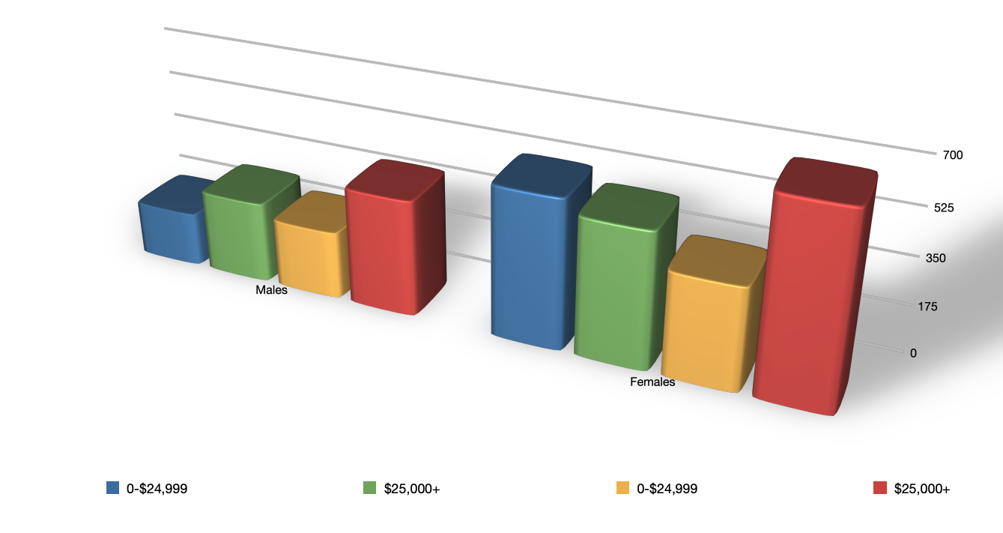
How about 3D visualizations?
Does the introduction of 3D here help us understand the data?

Slide 23
Design principle: No unjustified 3d
So much can go wrong when we use 3D to display data that could be presented in 2D
Depth judgement is not great
Occlusion
Perspective distortion
Color- lighting/shadows/shading
Tilted text is hard to read

Slide 24
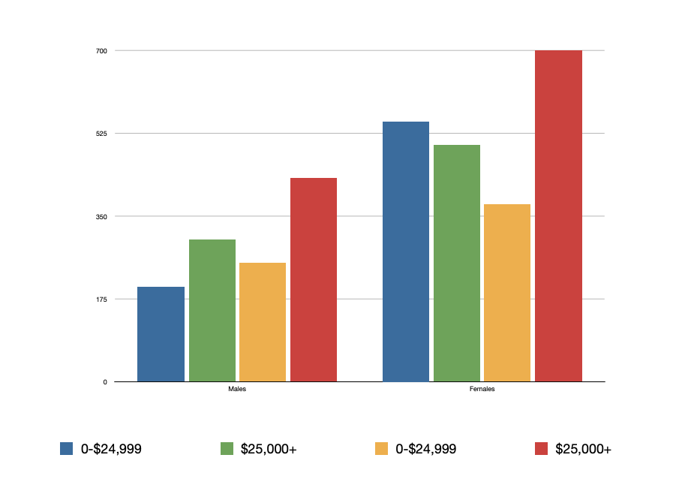
Better?

Slide 25
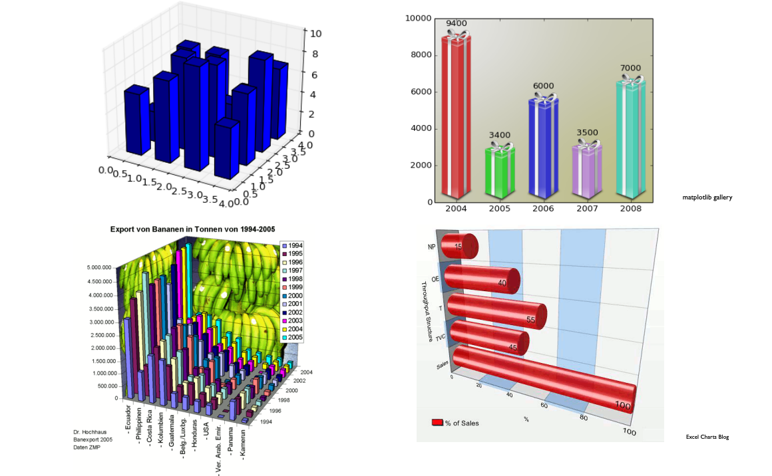
Just no

Slide 26
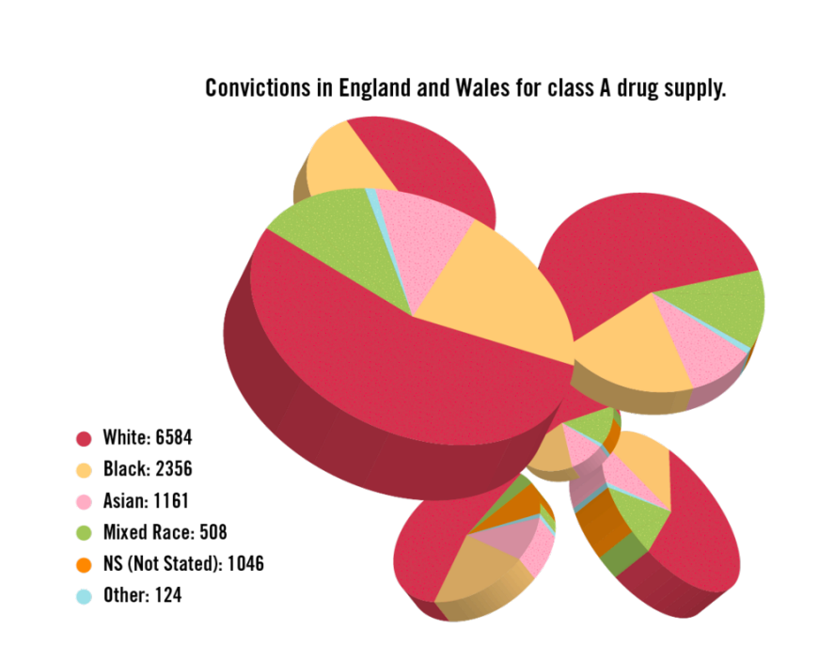
Whyyyyyyy

Slide 27
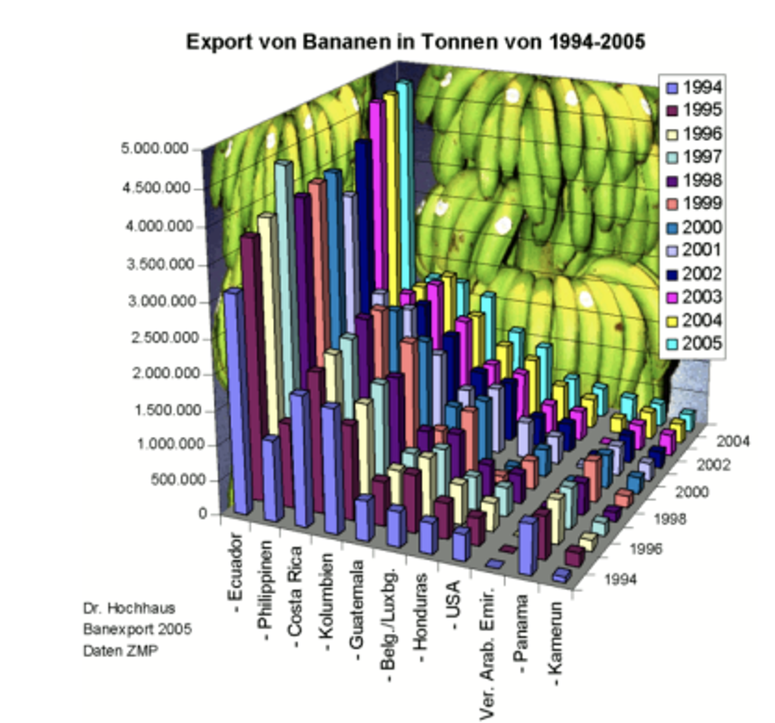
Thoughts?

Slide 28
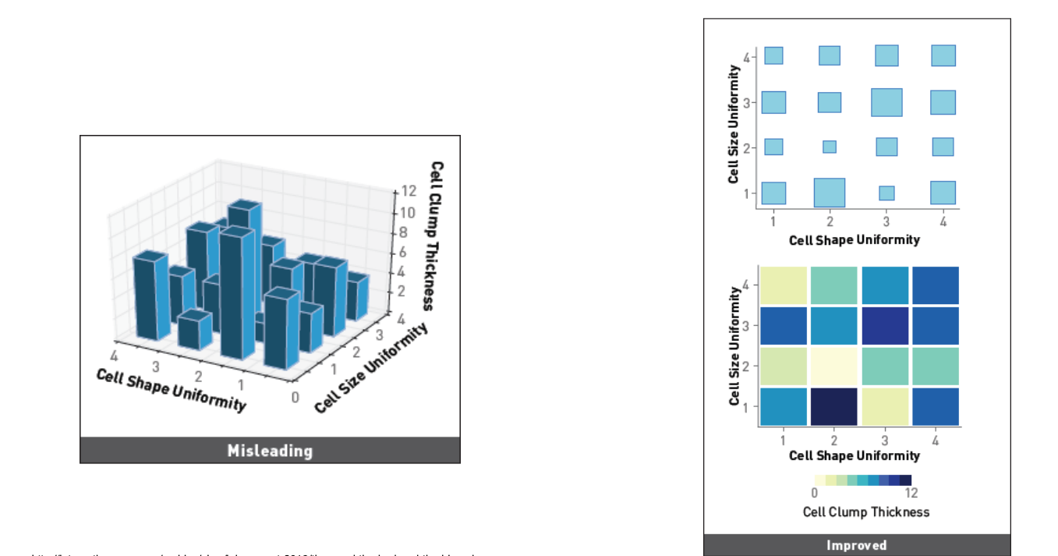
3d design alternatives (and more….)

Slide 29
Design principle : Focus on the data, not extraneous elements
Convey your data through visual channels
Minimize everything else
Why?
Your goal is to communicate the data to the user, with few distractions

Slide 30
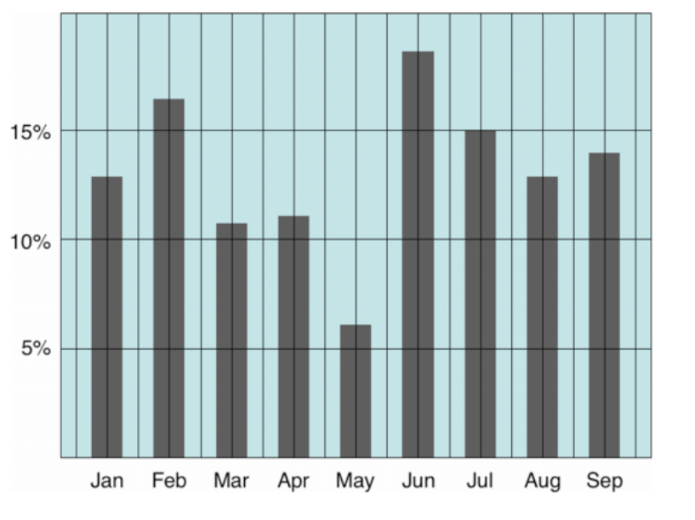
Avoid extraneous visual elements that distract from the message

Slide 31
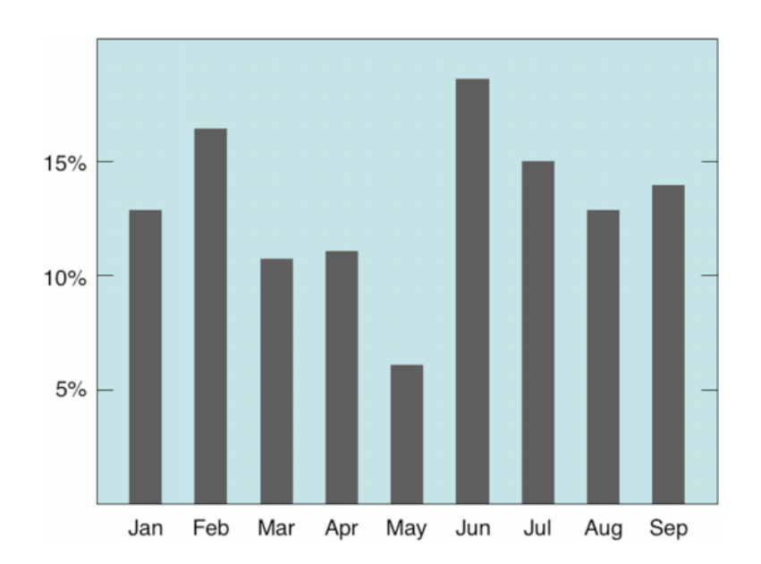
Avoid extraneous visual elements that distract from the message

Slide 32
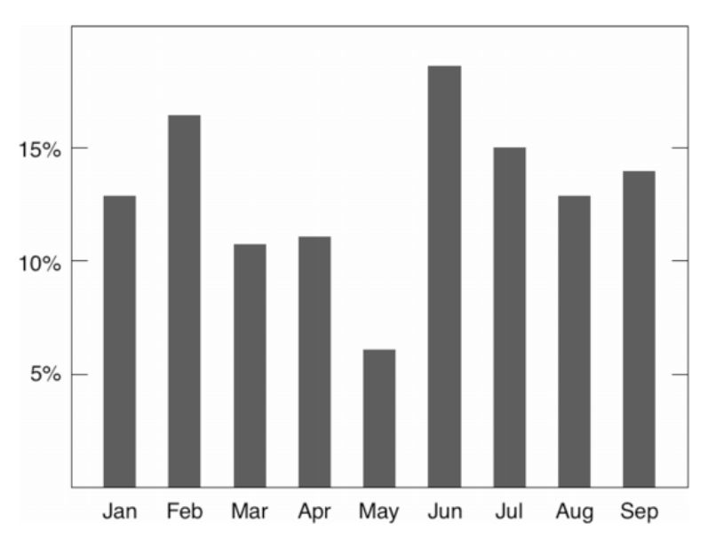
Avoid extraneous visual elements that distract from the message

Slide 33
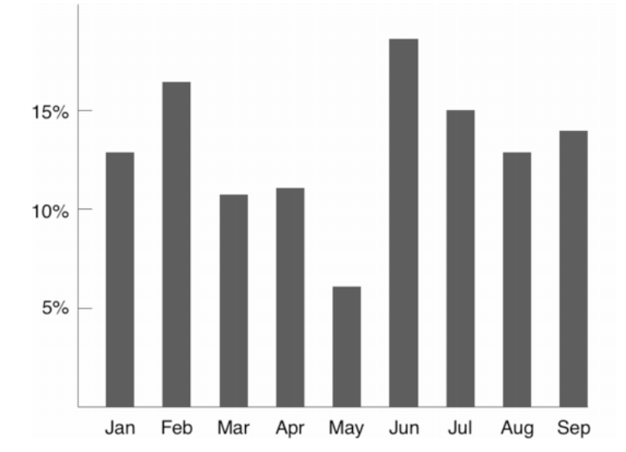
Avoid extraneous visual elements that distract from the message

Slide 34
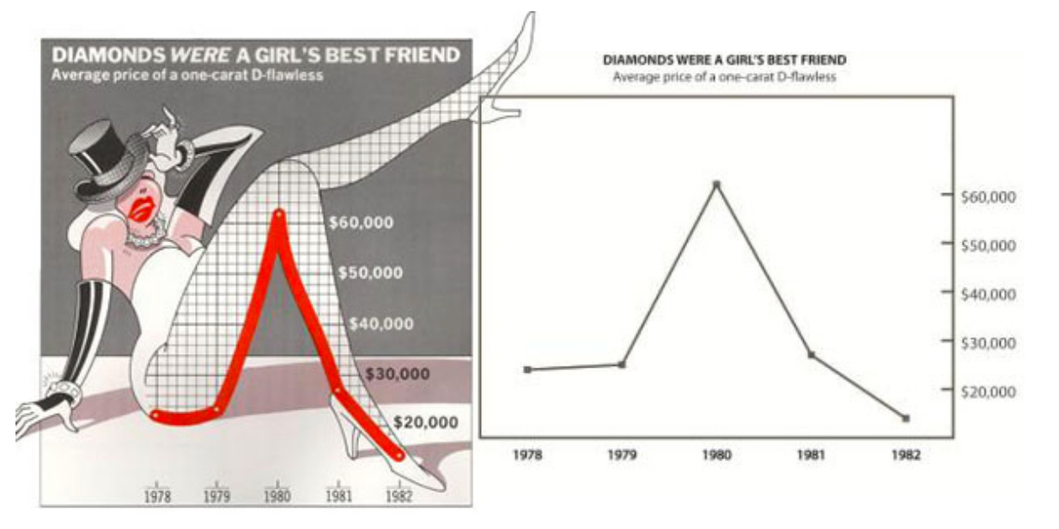
Example- is this chart junk?

Slide 35
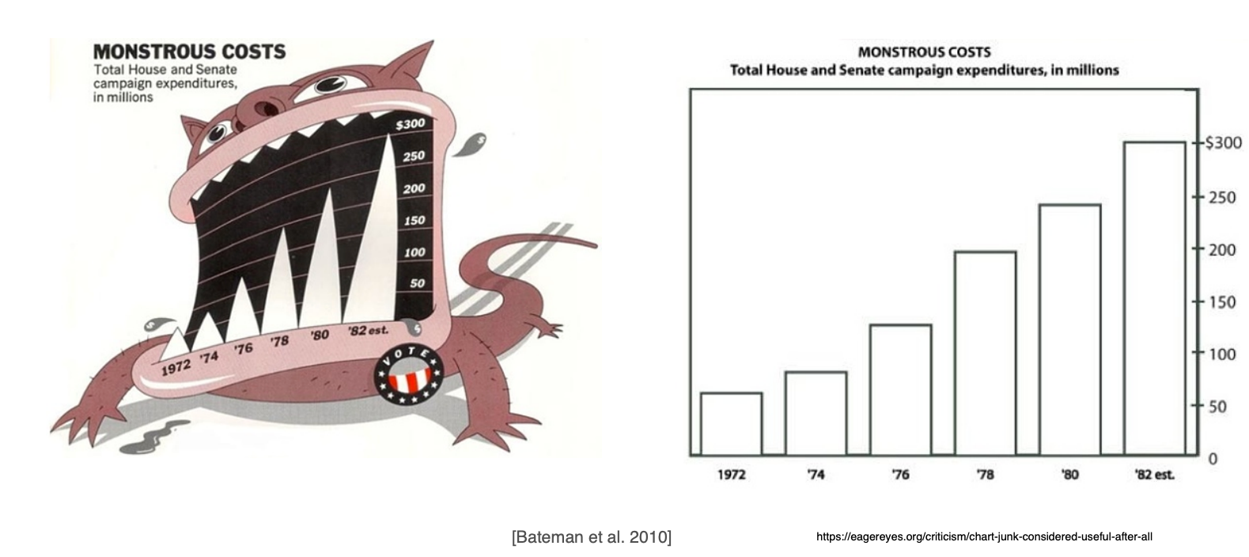
Is this chart junk?

Slide 36
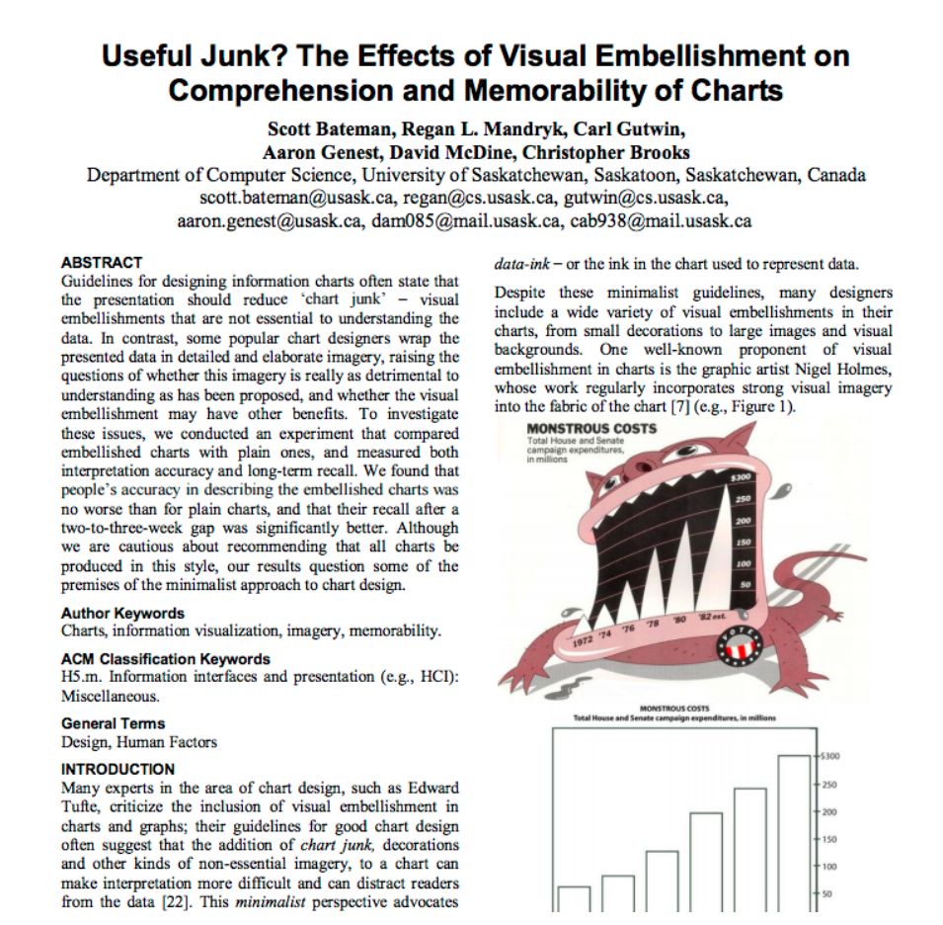

Slide 37
Experimental results
No difference in interpretation accuracy
No difference in recall accuracy after 5 min gap
Better recall of embellished chart topic and details after 2-3 weeks
Value message more clear to viewers
Participants enjoyed the embellished chart more, and remembered them better

Slide 38
How to handle: More data than fits in one chart
What can we do?
Animation
Interaction
Multiple views

Slide 39
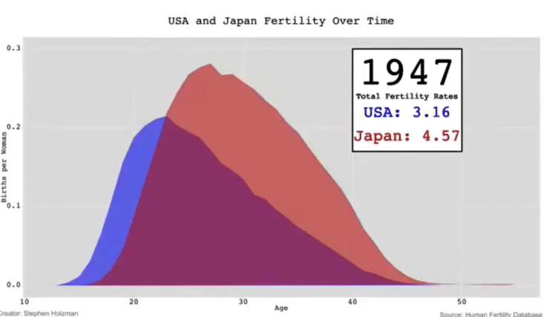
Animation: Is it easy to keep track of this?

Slide 40
Eyes beat memory
Direct perception is stronger than memory
Seeing the data represented in a visualization (or several visualizations) will allow the user to perform tasks more quickly and more accurately

Slide 41
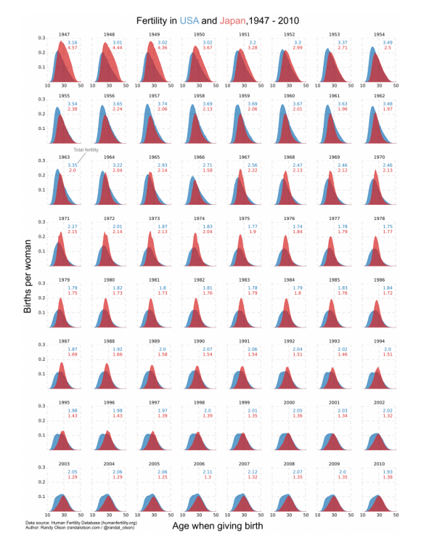
Alternative to animation
Small multiples: technique to show multiple partitions of the data in separate but identical charts

Slide 42
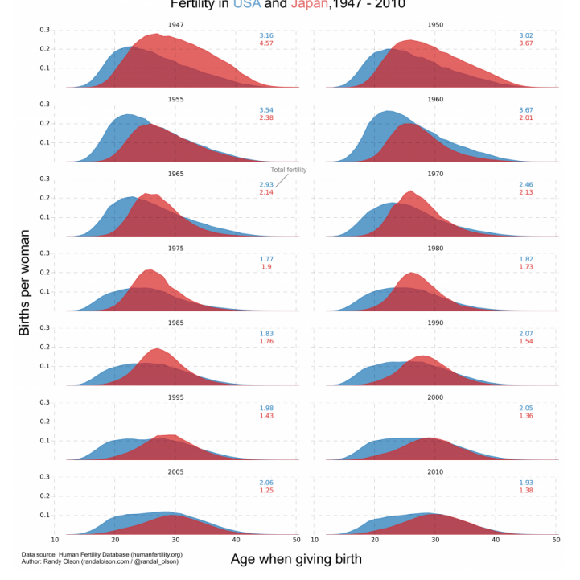
Reduced….

Slide 43
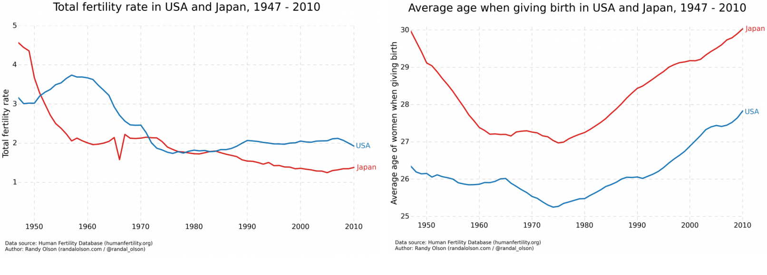
But what about this?

Slide 44
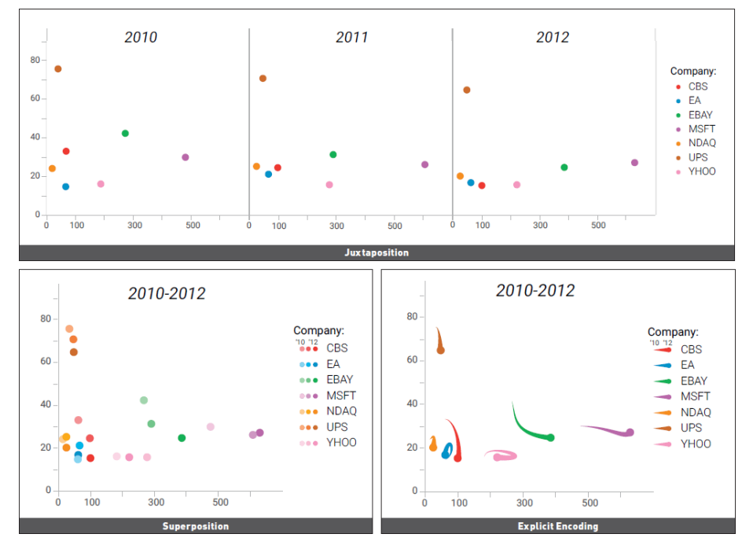
Small multiples
Juxtaposition of multiple subsets of the data, with respect to the same attributes
Often effective, but here maybe hard to track
Alternatives- superposition or explicit encoding

Slide 45
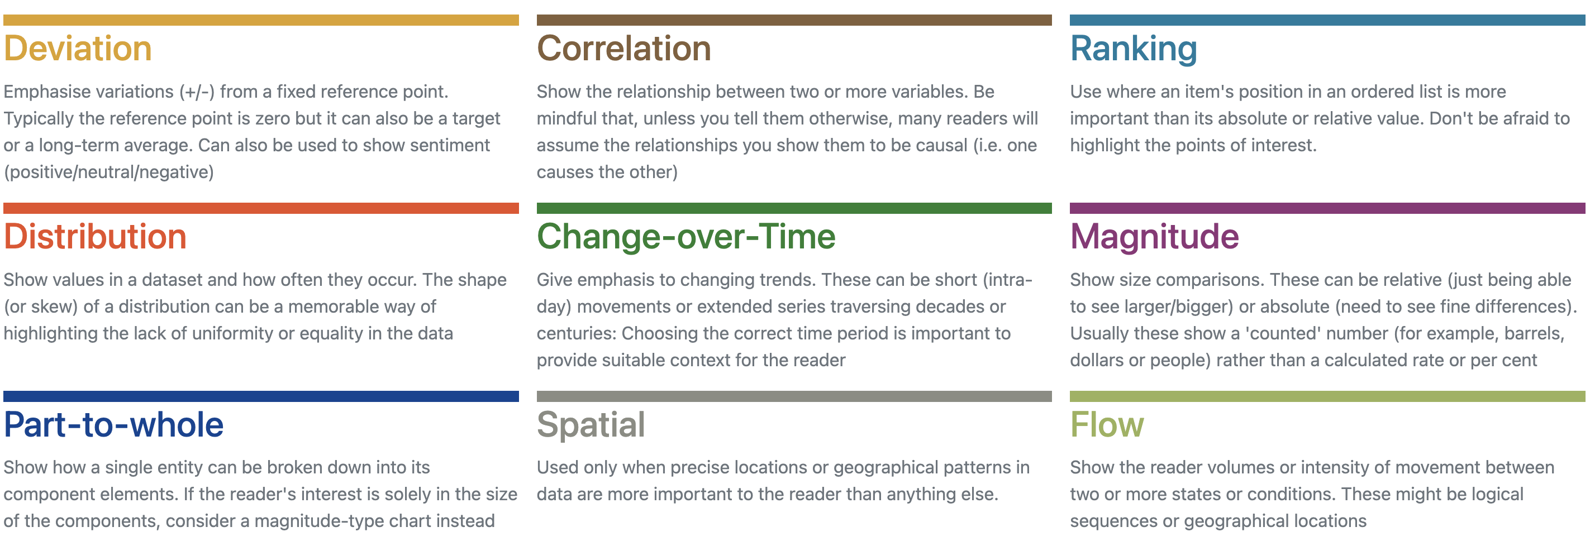
How to choose a visualization to communicate your data well?
Think about the aspect of the data that you want to communicate in your story
Select an appropriate visualization approach
https://gramener.github.io/visual-vocabulary-vega/#/Ranking/Links to an external site.

Slide 46
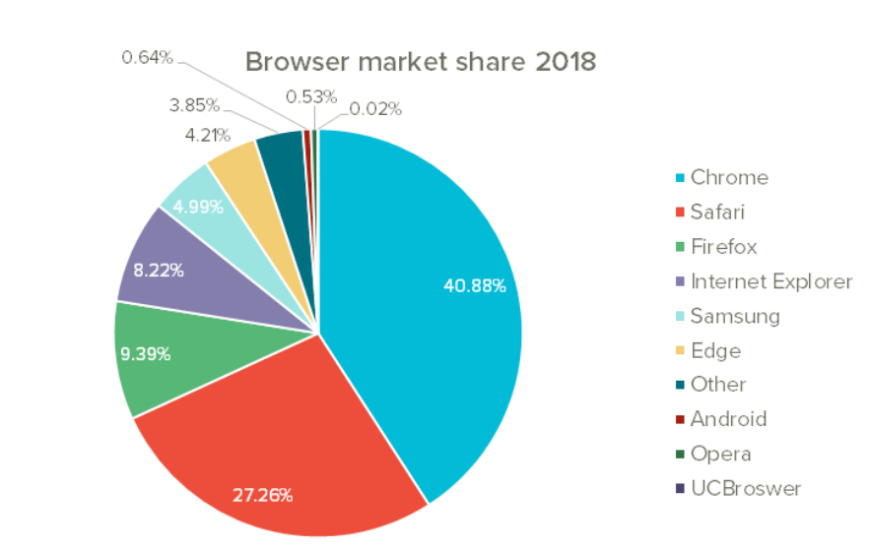
Considering pie charts
First of all: only use them when you want to show part-of-whole relationships
What is a part to whole relationships?
Frequent misuse of pie charts in the world

Slide 47
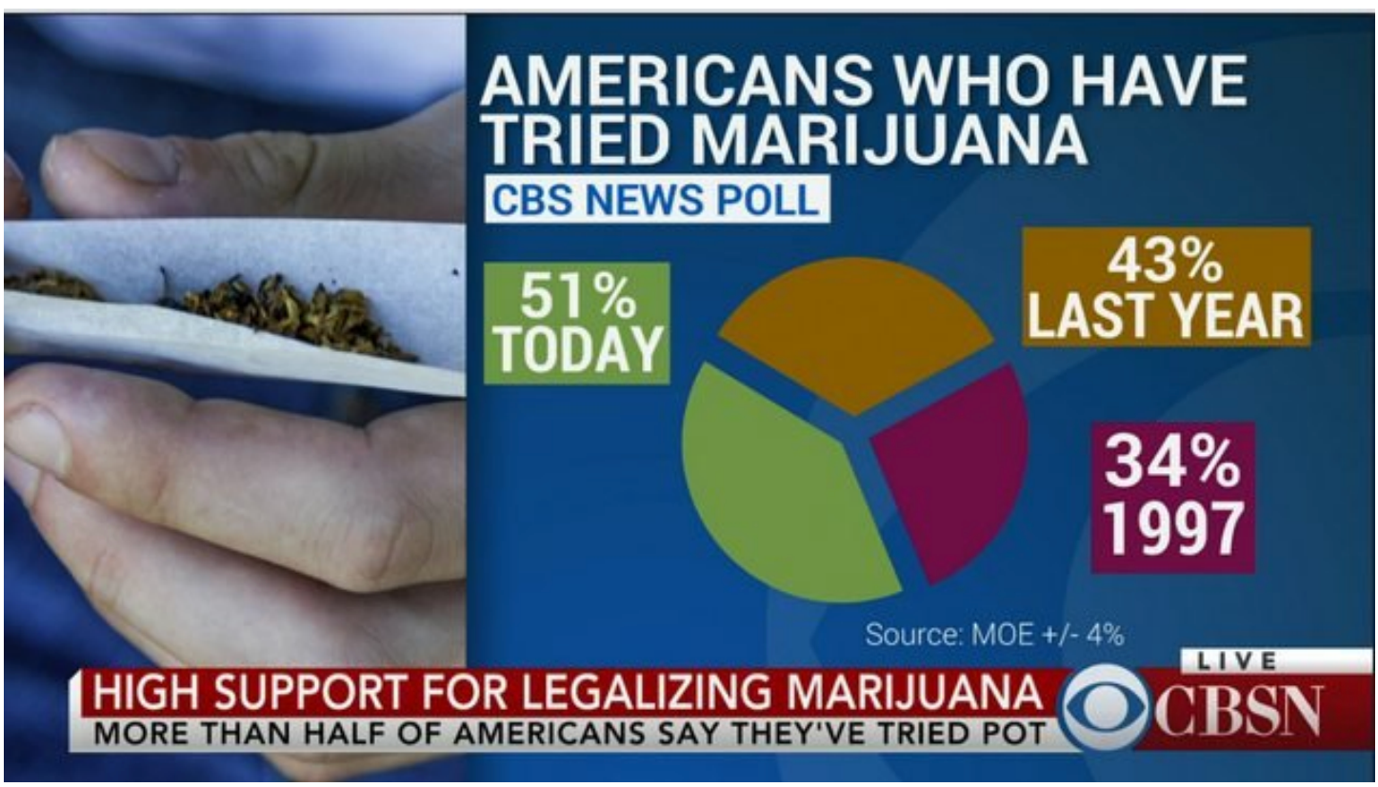
Pie chart??? WHY
What is this?

Slide 48
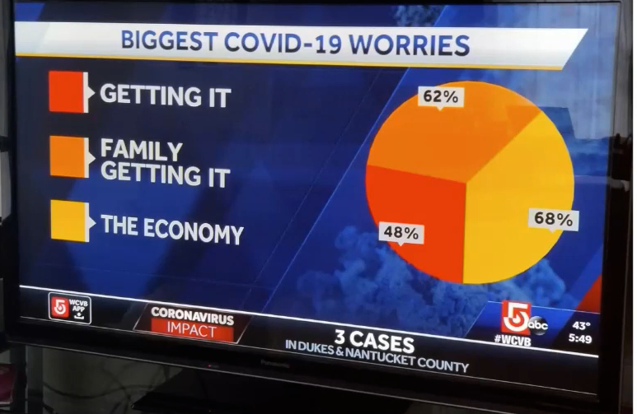

Slide 49
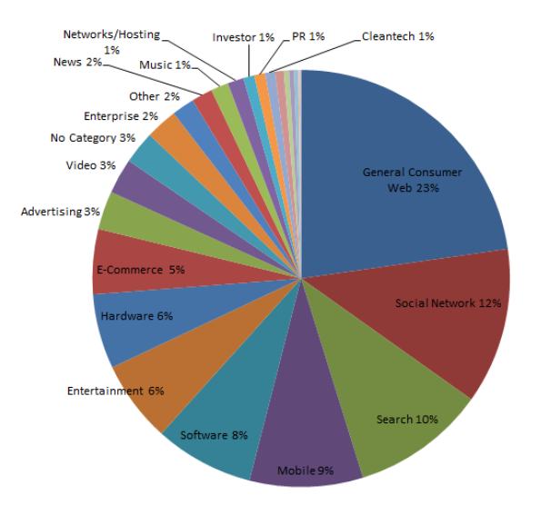
Critique?

Slide 50
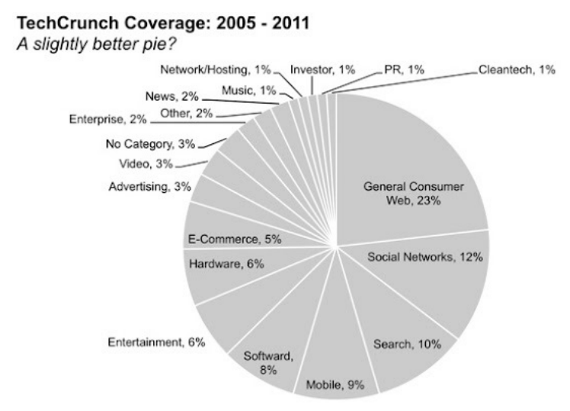
Design alternative

Slide 51
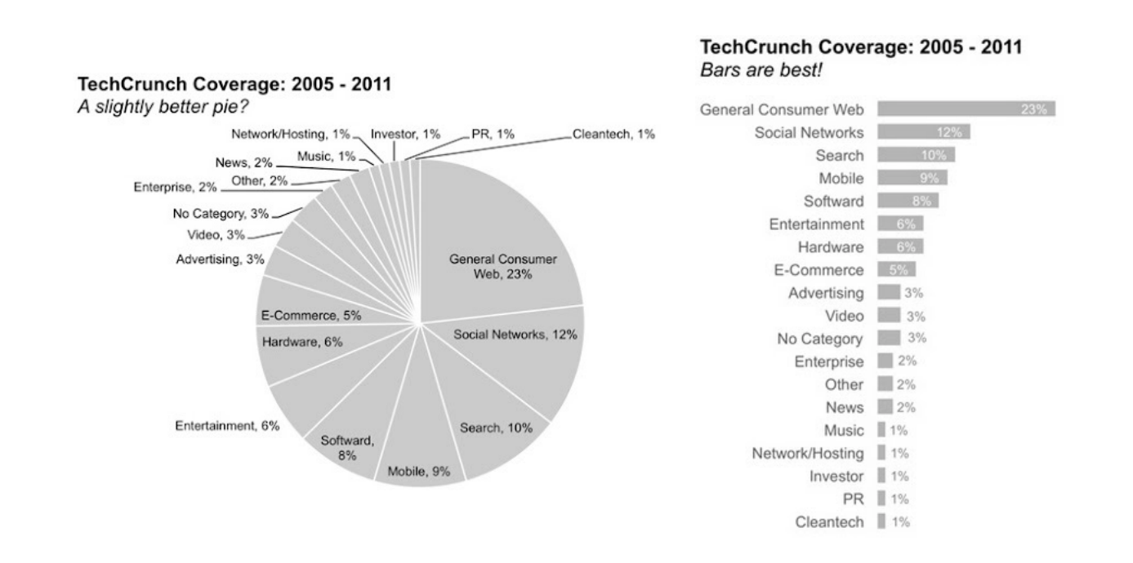
Bar vs pie

Slide 52
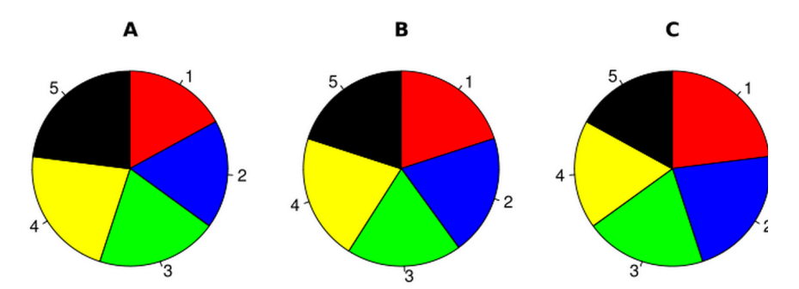
Can you see the differences?

Slide 53
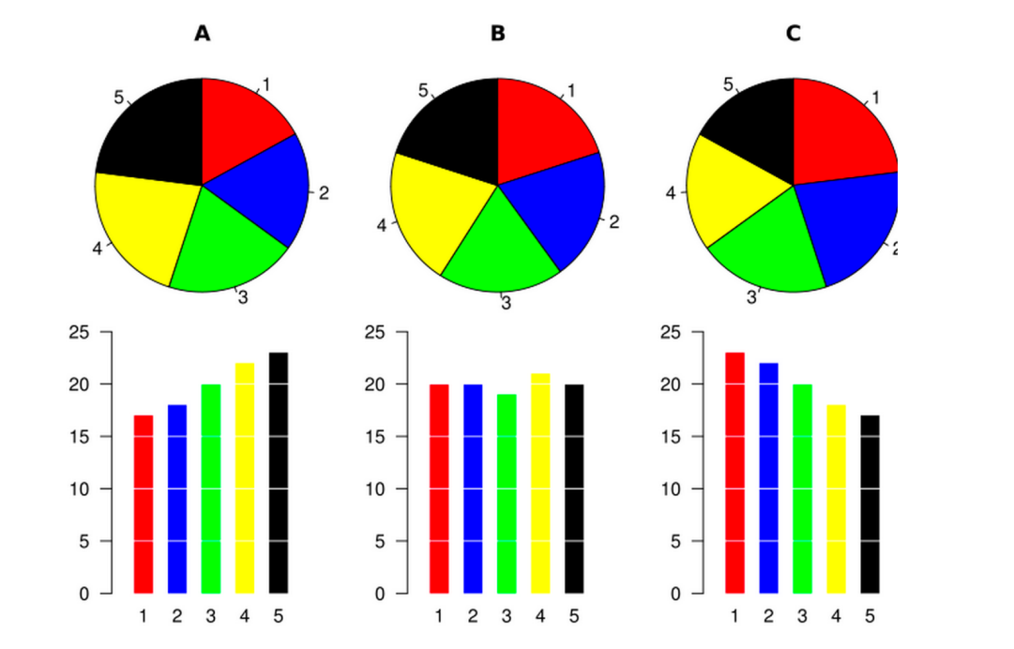
How about now?

Slide 54
Design alternatives
Suppose you had just run a summer program for 2nd and 3rd grade students about science
You want to show how their perceptions changed
You did a survey, before the program and after
Questions:
How do you feel about doing science?
Bored, Not great, ok, kind of interested, excited

Slide 55
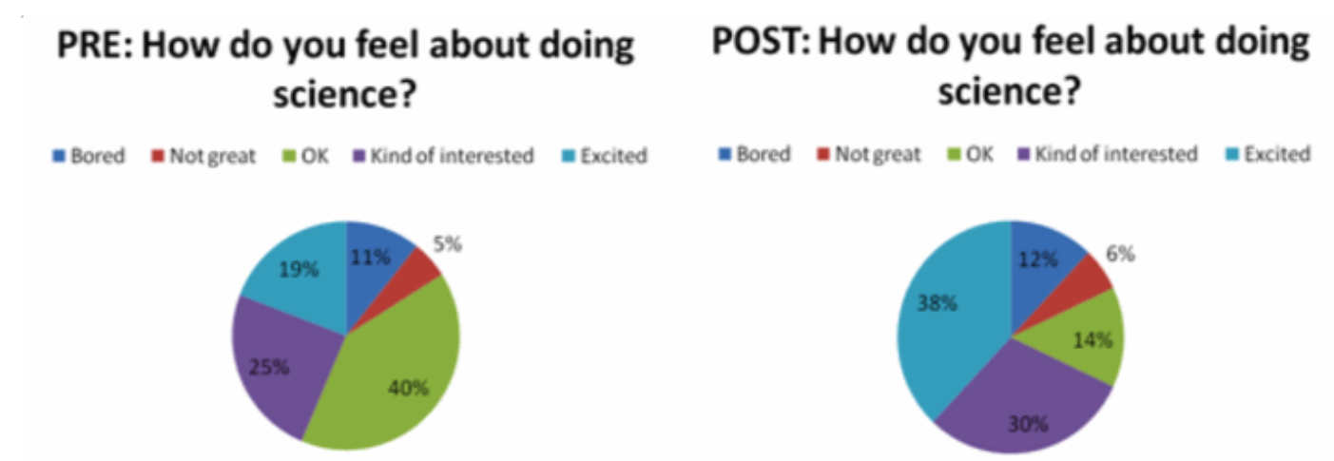
Design approach 1
Pie charts
What visual channels are used?
What tasks can someone perform using this design? What tasks are harder to perform?
How could we improve it?
What visual channels are we using?

Slide 56
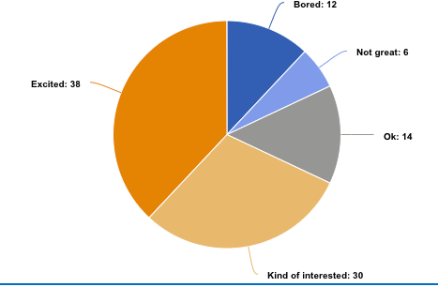
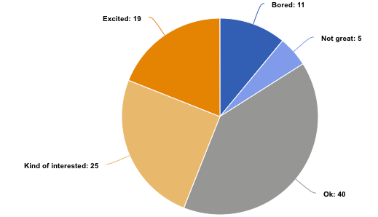
Pie-chart re-design
Let’s reconsider those colors
After
Before

Slide 57
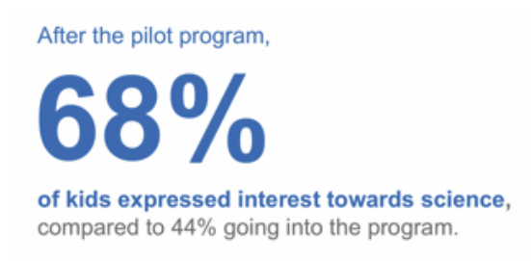
Design alternative
Just show the numbers
What visual channels are used?
What tasks can someone perform using this design? What tasks are harder to perform?
How could we improve it?

Slide 58
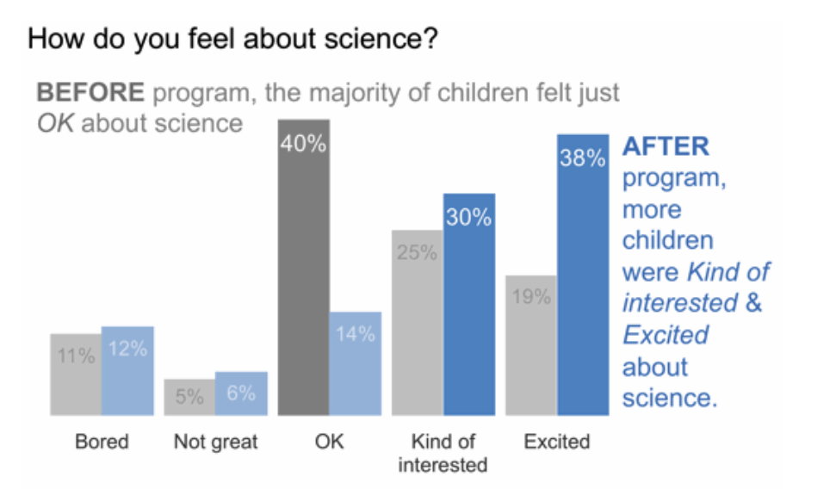
Design alternative:
Grouped bar chart:
What visual channels are used?
What tasks can someone perform using this design? What tasks are harder to perform?
How could we improve it?

Slide 59
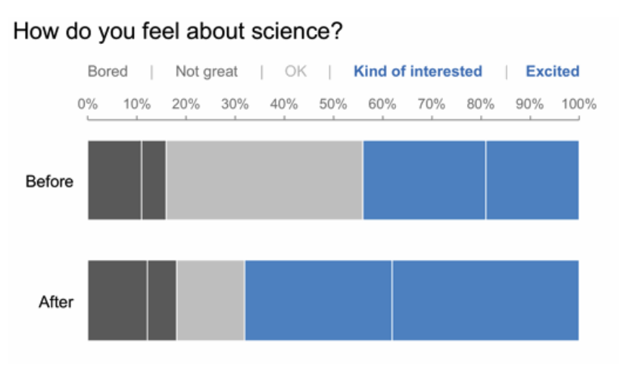
Design alternatives:
Stacked bar chart:
What visual channels are used?
What tasks can someone perform using this design? What tasks are harder to perform?
How could we improve it?

Slide 60
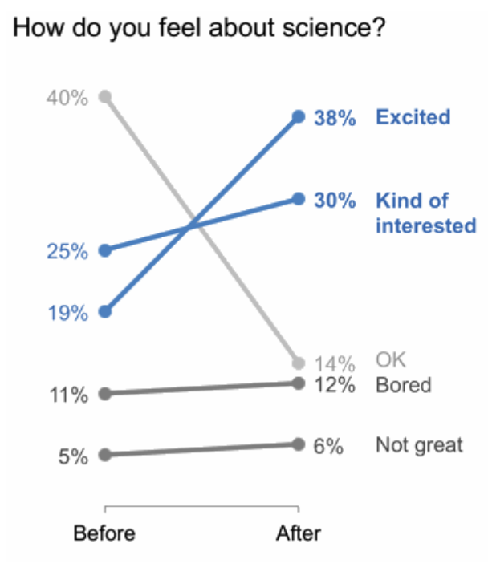
Design alternative: slope graph
Slope graph
What visual channels are used?
What tasks can someone perform using this design? What tasks are harder to perform?
How could we improve it?

Slide 61
Lots of options

Slide 62
A moment in defense of the pie chart….
Vis people hate pie charts
But, what if your end user finds them to be familiar and they use them routinely?
Are there any other benefits to a pie chart?

Slide 63
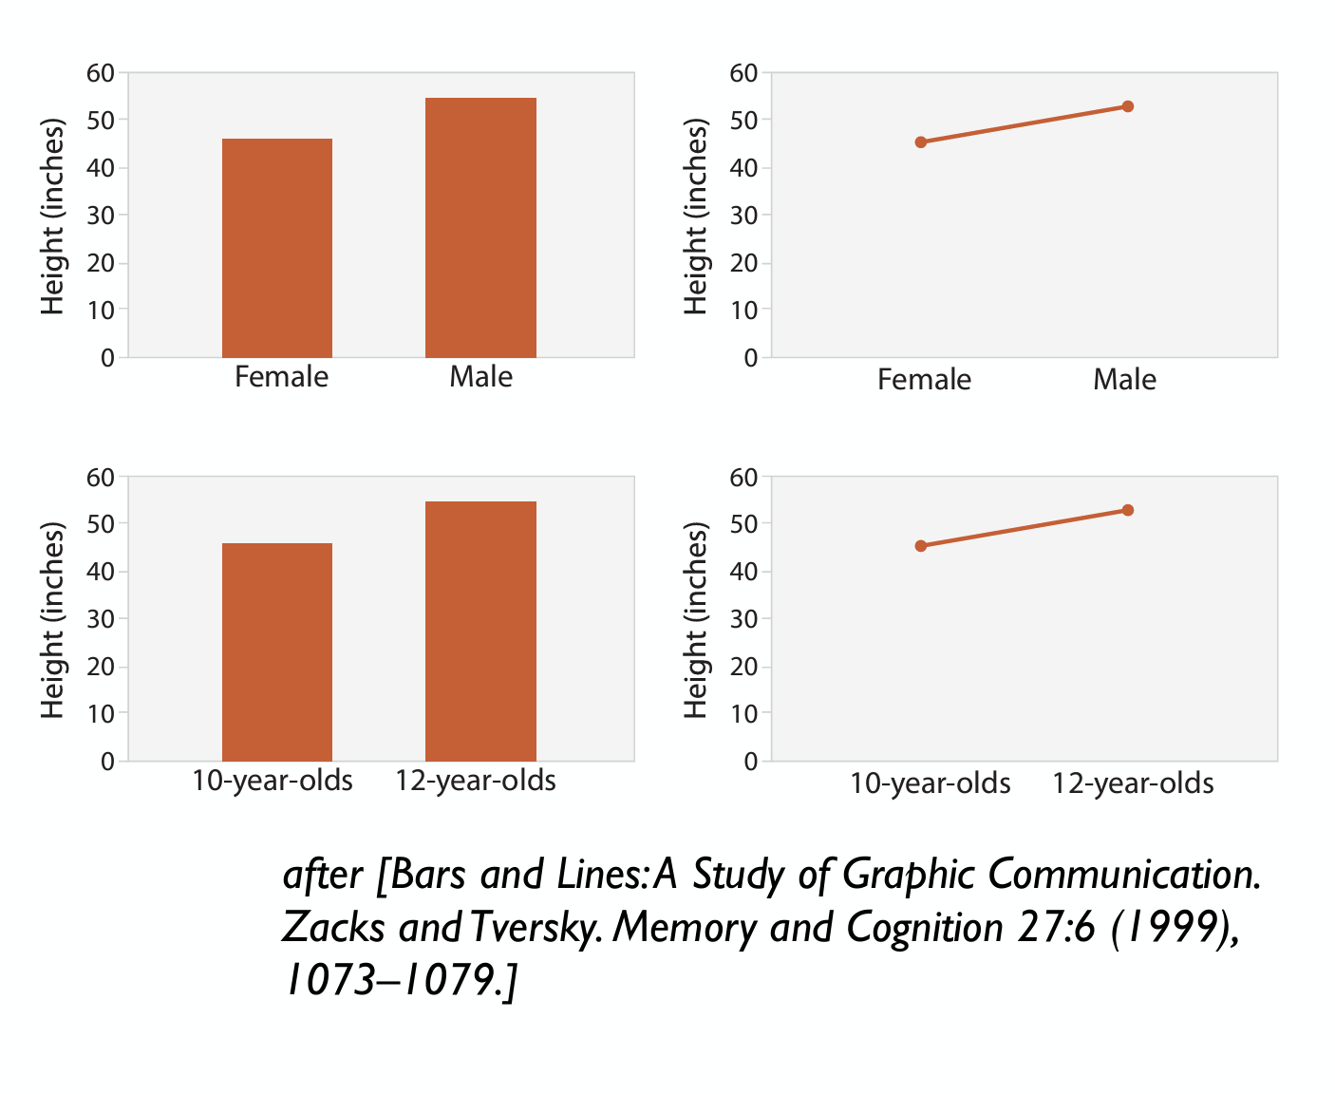
Bar chart vs Line chart
Don’t use a line chart if the data isn’t ordered and continuous
No trend
No interpolation between measurement points
In this example, does it make sense to say:
The more male someone is the taller they are?
The older someone is the taller they are?

Slide 64
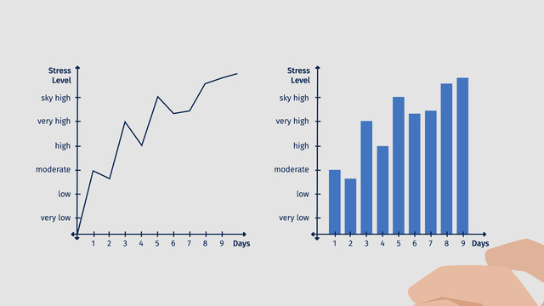
For data with a temporal dimension…
Line or Bar?
Line chart conveys continuity.
Mentally we assume a smooth transition between measurements
Interpolation
Bar charts convey discrete measurements
Which do we prefer here?

Slide 65
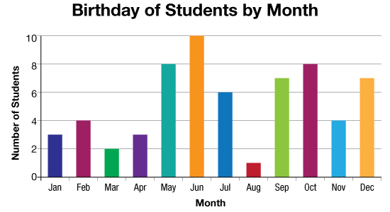
For data with a temporal dimension…
Does this make sense as a line chart?

Slide 66

Distributions of data- histograms
What if you have sets of measurements, and you want to show their distribution
How many measurements fall in different brackets
Frequencies
Of different measurements
Example- frequency of response times
What task does this support?

Slide 67

And more kinds of visualizations…
https://gramener.github.io/visual-vocabulary-vega/#/Ranking/Links to an external site.

